Slide 1


Slide 2

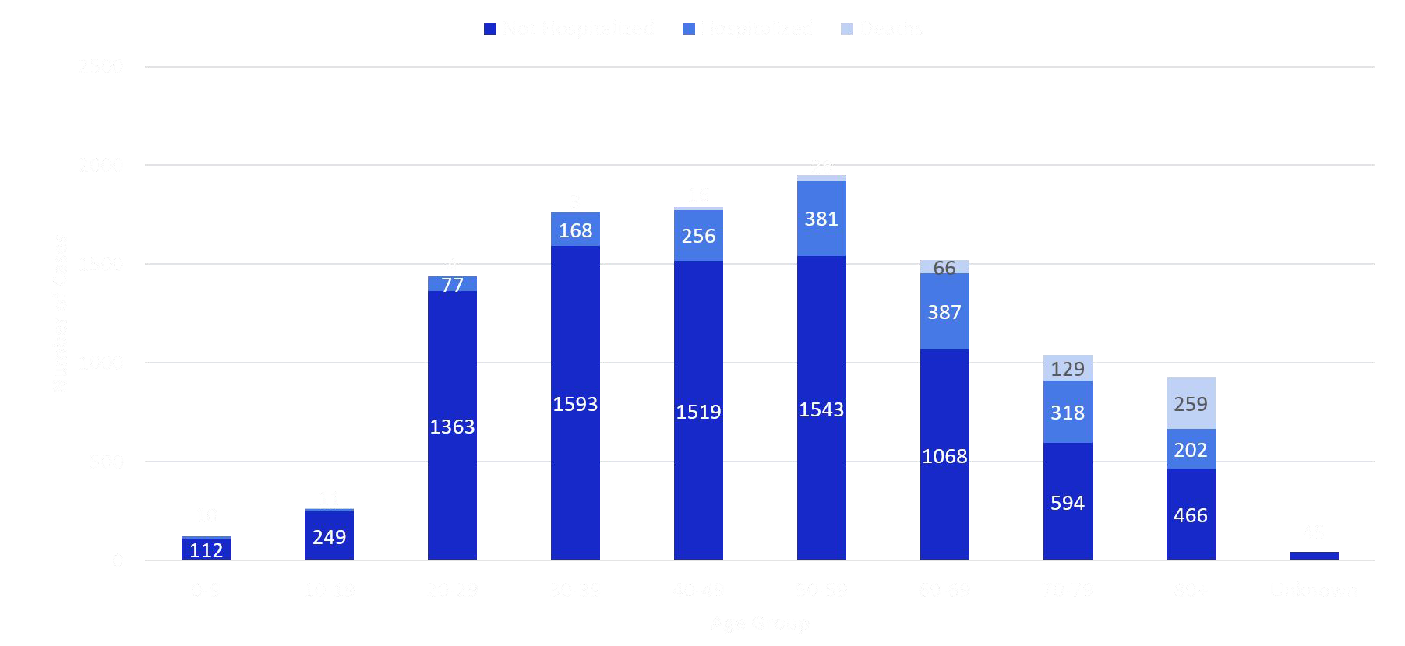
CO CASES OF COVID-19 BY AGE GROUP, HOSPITALIZATION AND OUTCOME

Slide 3





SAFER AT HOME
Vulnerable populations and older adults must stay at home except when absolutely necessary
Retail businesses open for curbside delivery and phased-in public opening with strict precautions
No group gatherings over 10 people
Restaurants and bars remain closed except for takeout/delivery. Work towards phased reopening.
Critical businesses remain open with strict precautions (social distancing, masks for all employees, more frequent cleanings, etc.)

Slide 4





SAFER AT HOME
Nightclubs, gyms and spas remain closed
Elective medical and dental procedures begin, with strict precautions to ensure adequate personal protective equipment and the ability to meet critical care needs
Personal services (salons, dog grooming, personal training, etc) will open with strict precautions
K-12 schools remain closed for the 2019-2020 school year
Telecommuting continues for offices. Starting May 4, up to 50% of staff can work in person (with social distancing in place)

Slide 5

➔ | Continuing to stay at home as much as possible | ➔ | A free-for-all
 | and if you leave, do it for very specific tasks. | ➔ | An opportunity to leave the house as much
➔ | For older adults and/or have a chronic condition, |  | as possible and spread the virus to others
 | you MUST stay at home unless necessary | ➔ | An excuse to not wear a facial covering or
➔ | Continuing to wear a facial covering and |  | hug or give a handshake
 | practice social distancing - 6ft. | ➔ | Going to the mountains to spend the
➔ | Recreating close to your home - no more than |  | weekend
 | 10 miles. | ➔ | Conducting unnecessary travel
➔ | Continuing to limit interactions to members of | ➔ | Having parties or get togethers
 | your household | ➔ | Pick up soccer games or neighborhood
➔ | Gatherings no more than 10 people |  | BBQ’s

Slide 6
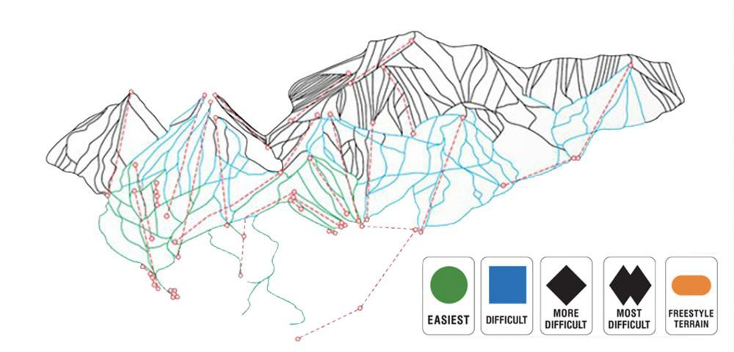
LET’S EXPLAIN IN COLORADO TERMS

Slide 7


LET’S EXPLAIN IN COLORADO TERMS
Going here (9,000 feet)
We are here (8,000 feet)

Slide 8
GUIDELINES HAVE TO TAKE INTO ACCOUNT EXPOSURE RISK AND ABILITY TO DO PREVENTION IN DIFFERENT SETTINGS
Dog Grooming Retail Sporting Event
Low
High
Exposure Risk
Dorms
Social Gatherings
Low
High
Ability to do Prevention

Slide 9
SAFER AT HOME: GUIDANCE FOR THE GENERAL PUBLIC
Practices for... | Key Steps
General Public | Follow Safer at Home guidelines Strongly advised face coverings and staying 6ft apart in public No gatherings over 10 people Sick people may not go to work Limit non-essential travel
Vulnerable Populations and Older Adults | Stay safer at home and continue to only go out when absolutely necessary Utilize special industry hours for vulnerable populations
What Does This Mean for Seeing My Friends and Family? | People should still limit interactions except with immediate household If you do see limited family or friends outside of your household, be extra cautious to stay 6 ft apart, wear face covering, and limit contact Stick to solo (or with those you live with) and non-contact recreation activities like running, walking, or hiking in your local community. Do not travel outside of your local community for recreation. Avoid contact sports or equipment.

Slide 10
ALL INDUSTRIES SHOULD IMPLEMENT GENERAL BEST PRACTICES
Practices for... | Key Steps
Worksites | Deputize workplace coordinator(s) charged with addressing COVID-19 issues Maintain 6 foot separation when possible, and discourage shared spaces Sanitize all high touch areas Post signage for employees and customers on good hygiene Ensure proper ventilation Avoid gatherings (meetings, waiting rooms, etc) of more than 10 people Implement symptom monitoring protocols (including workplace temperature monitoring) where possible Eliminate or regularly sanitize any items in common spaces (i.e., break rooms) that are shared between individuals (i.e., condiments, coffee makers, vending machines)
Employees | Require employees to stay home when showing any symptoms or signs of sickness, and connect employees to company or state benefits providers Provide flexible or remote scheduling for employees who need to continue to Stay at Home, who may have child or elder care obligations, or who live with a person who still needs to observe Stay at Home due to underlying condition, age, or other factor Encourage and enable remote work whenever possible Encourage breaks to wash hands or use hand sanitizer Phase shifts, breaks to reduce density Provide appropriate protective gear like gloves, masks, and face coverings
Retailers | Create special hours for vulnerable populations only Encourage 6 foot distancing inside of the business for all patrons Encourage use of protection like gloves, masks, face coverings Provide hand sanitizer at entrance Use contactless payment solutions, no touch trash cans, etc. whenever possible

Slide 11

SPECIFIC BEST PRACTICES WILL SOON BE PROVIDED
¹ All critical businesses continue to operate as presently doing based on Safe at Home protocols

Slide 12




LOCAL GOVERNMENTS: THREE OPTIONS
MATCH THE STATE GUIDELINES
Implement the guidelines of Safer at Home to match the state
MORE PROTECTIONS
LOCAL FLEXIBILITY
Going farther than the state, including but not limited to stay at home orders or additional protective measures.
To relax guidelines further than the state, local governments need to have very low case counts and/or demonstrate proof of 14 consecutive days of decline of infection of COVID-19 in the jurisdiction.
The application must include a written COVID-19 suppression plan approved by the appropriate local public health authority. all hospitals within the jurisdiction and elected leadership.

Slide 13



TIMELINE FOR IMPLEMENTATION
Through April 26:
Stay At Home
April 27:
Safer at Home
May 1 (Friday):
Safer at Home
May 4 (Monday):
Safer at Home
Last Day of Stay at Home Order
Safer at Home Order Issued
Can open if implementing best practices:
Can open if implementing best practices:
Retail - Curbside can begin
Real Estate - showings can resume
Retail
Some personal Services
Office work at reduced density

Slide 14

SCENARIO G: PARTIALLY RELAX SOCIAL DISTANCING AND PURSUE AGGRESSIVE CASE DETECTION AND ISOLATION
Isolate 80% of symptomatic cases within 48 hours of infectiousness -- very aggressive testing and containment program
*Does not include contact tracing
¹ All critical businesses continue to operate as presently doing based on Safe at Home protocols

Slide 15
SCENARIO G: PARTIALLY RELAX SOCIAL DISTANCING AND PURSUE AGGRESSIVE CASE DETECTION AND ISOLATION
 | Implement 4/27 |  | Implement 5/11 |  | Implement 5/25
 | Approximate date ICU threshold is reached | Estimated peak ICU need* | Approximate date ICU threshold is reached | Estimated peak ICU need* | Approximate date ICU threshold is reached | Estimated peak ICU need*
Scenario G - 80% case isolation | 06/15/2020 | 12,800 | 07/02/2020 | 12,600 | 07/20/2020 | 12,500
*Does not include contact tracing
¹ All critical businesses continue to operate as presently doing based on Safe at Home protocols

Slide 16

TESTING/MODEL: SCENARIO F
Scenario F tests these assumptions with social distancing levels of 65%, 55%, and 45%
¹ All critical businesses continue to operate as presently doing based on Safe at Home protocols

Slide 17
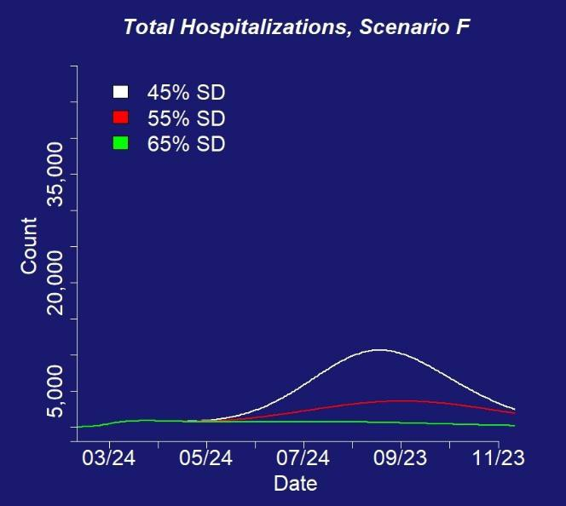
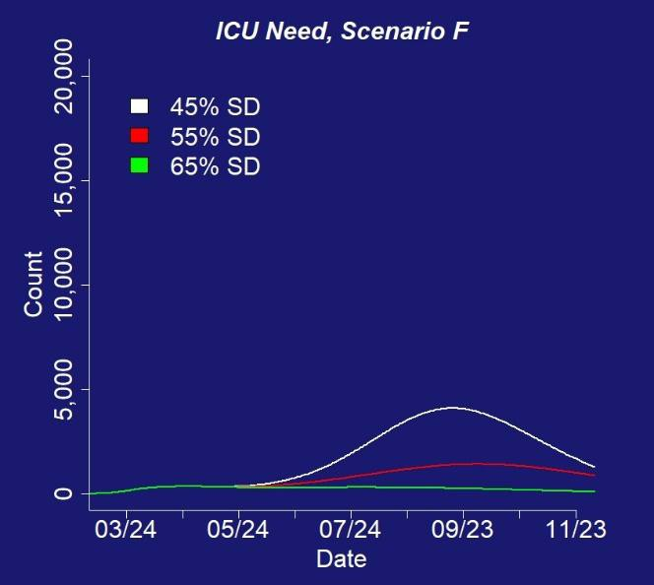
SCENARIO F: ALL INTERVENTIONS

Slide 18
Projected timing and magnitude of the peak number of ICU hospitalizations for interventions (Scenario F)
 | Relax social distancing to 45% |  | Relax social distancing to 55% |  | Relax social distancing to 65%
 | Est. peak ICU need* | Est. date of ICU peak | Est. peak ICU need* | Est. date of ICU peak | Est. peak ICU need* | Est date of ICU peak
Scenario F: Mask wearing, improved case detection and containment, and older adults maintain current high levels of social distancing | 4,100 | 09/10/2020 | 1,420 | 09/24/2020 | 355 | 04/21/2020

Slide 19
UPDATE ON TESTING
150,000 tests are arriving in Colorado by the end of the week
We’ve ordered 150,000 swabs and are expecting delivery mid-May, just received 20,000 swabs
The state is partnering with Colorado State University to expand testing for workers at skilled nursing facilities who are treating the most vulnerable populations.
We are excited to work with the Gary Community Foundation to deploy hundreds of thousands of antibody tests to better understand disease surveillance and exposure.

Slide 20
COLORADO IS PURSUING AN ALL OF THE ABOVE STRATEGY
1.) 60-65% social distancing maintained
2.) Vulnerable populations and older adults must stay at home except when absolutely necessary
3.) Increased protection measures, compliance and enforcement for senior congregate care facilities
4.) Increasing testing and aggressive contact tracing program 5.) Building more healthcare capacity
6.) Face covering wearing culture
7.) Excellent hygiene at all times (hand washing)

Slide 21
TAKEAWAYS
We must maintain sustainable, high levels of social distancing
Seniors and vulnerable populations need to maintain even higher levels of social distancing.
Each intervention (testing, containment, wearing masks,
sustainable social distancing, strong precautions for seniors and vulnerable populations) alone does not keep us below hospital capacity.
A successful strategy is a combination of all of these
interventions.

Slide 22

s I GOVERNOR JARED POLIS
#DoingMyPartCO

